Slide 1
10.4 Nonlinear Two-Class Classification

Slide 2
Modeling principles

Slide 3
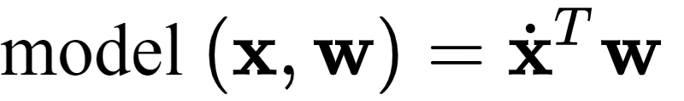
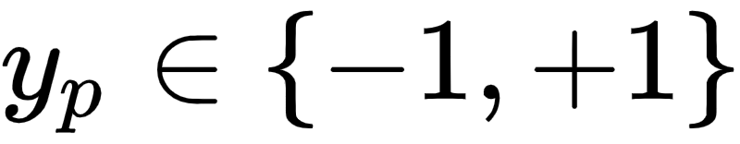
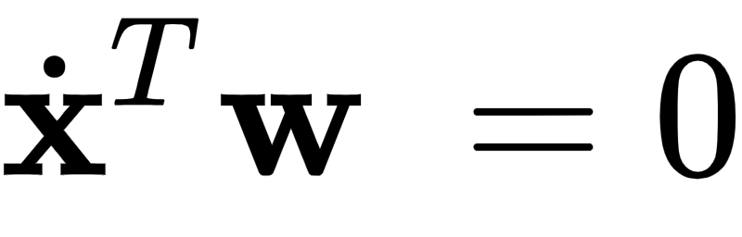
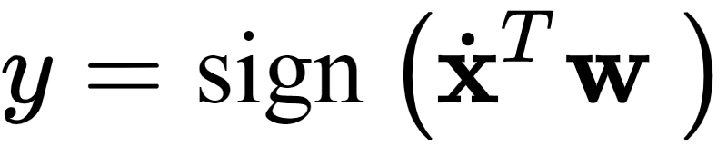
Linear two-class classification uses the linear model
The linear decision boundary - employing by default label values then lies precisely where
And, label predictions are made as

Slide 4
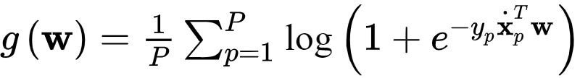
To tune the set of weights properly for a given dataset we must minimize a proper two-class classification cost function, e.g., the Softmax/Cross-Entropy cost given by

Slide 5
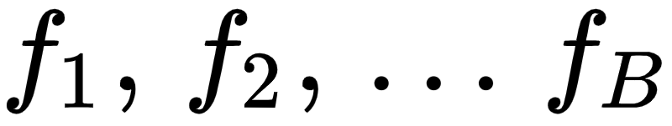
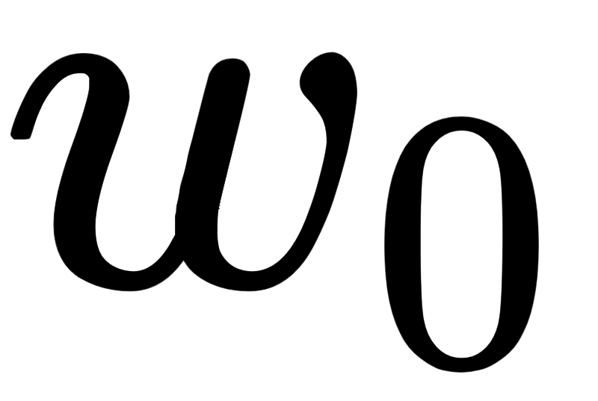
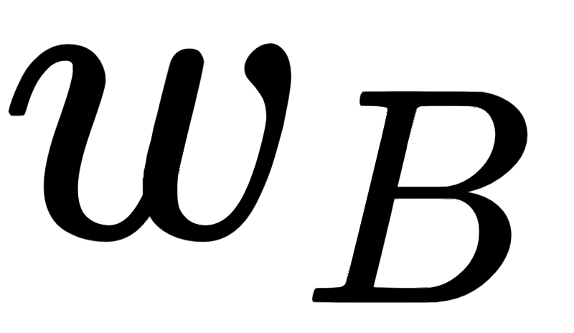

While we previously employed a linear model in deriving linear two-class classification schemes in Chapter 6, we could have just as well use any *nonlinear* model of the general form
Here are nonlinear parameterized or unparameterized functions - or *feature transformations*
Once again, through (along with any additional weights internal to the nonlinear functions) are represented in the weight set and must be tuned properly.

Slide 6
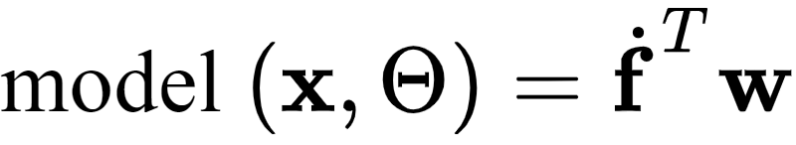
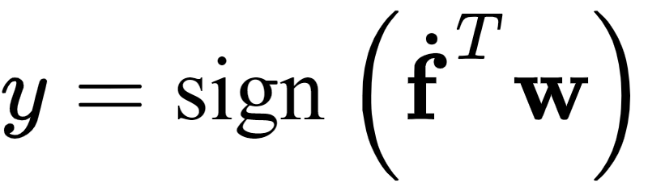
We can express this nonlinear model - using the same compact notation introduced previously - as
In complete analogy to the linear case, here our decision boundary consists of all inputs where
And, likewise predictions are made as

Slide 7
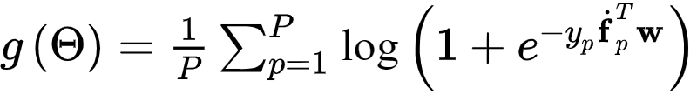
Likewise, to properly tune the parameters of we must minimize a proper cost function with respect to it, e.g., the Softmax cost

Slide 8
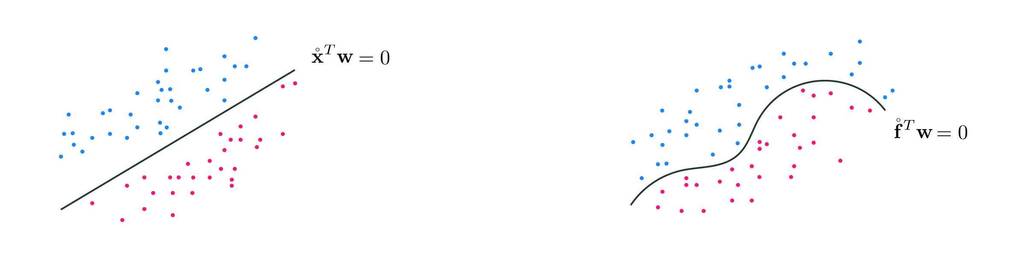
Abstract illustration of linear versus nonlinear two-class classification

Slide 9
Feature engineering

Slide 10
Example: Finding an elliptical boundary separating two classes

Slide 11
In this example we examine the following classification dataset with $N=2$ dimensional input, shown from both the regression perspective (left panel) and the Perceptron perspective (right panel).

Slide 12
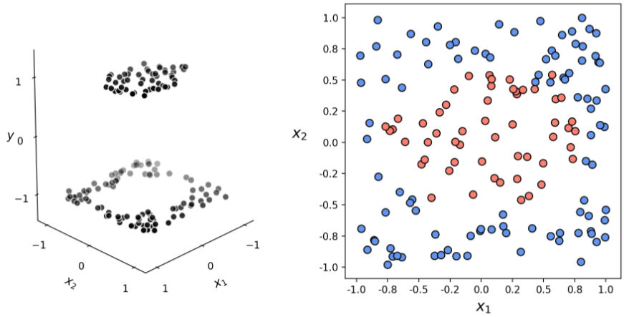

Slide 13
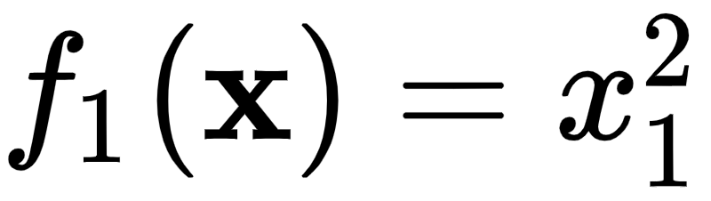
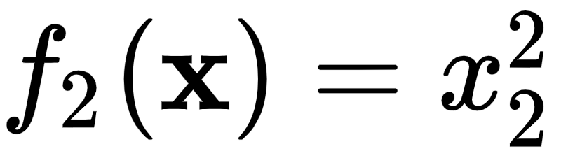
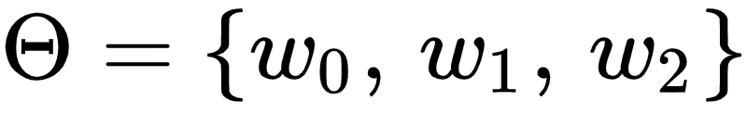
Visually examining the dataset it appears that some sort of elliptical decision boundary centered at the origin might do a fine job of classification.
Thus we set our `model` function to the general parameterized form of such an ellipse
Parsing this formula, we can see that we have used two feature transformations , , and the parameter set

Slide 14
With our weights tuned - by minimizing the Softmax cost via gradient descent - we can plot the data in its original space (left panels) along with the nonlinear decision boundary provided by the trained predictor, and in the transformed feature space (right panels) where the corresponding decision boundary is linear.

Slide 15
